Slide 1
Campaign Management System
A platform to improve by feedback

Slide 2
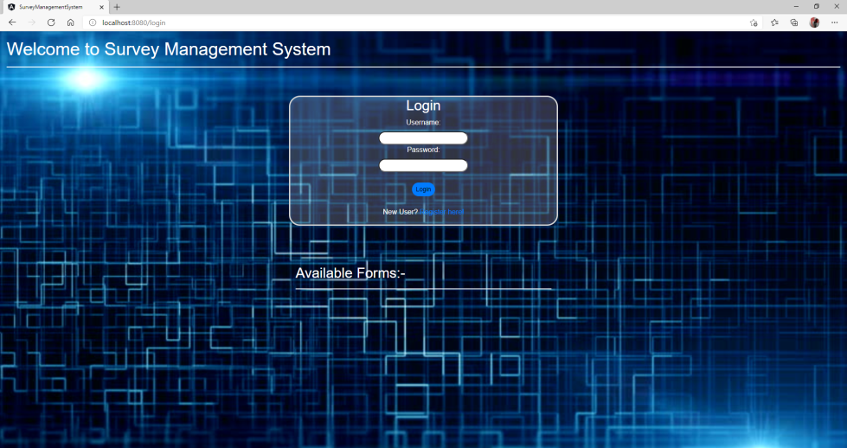
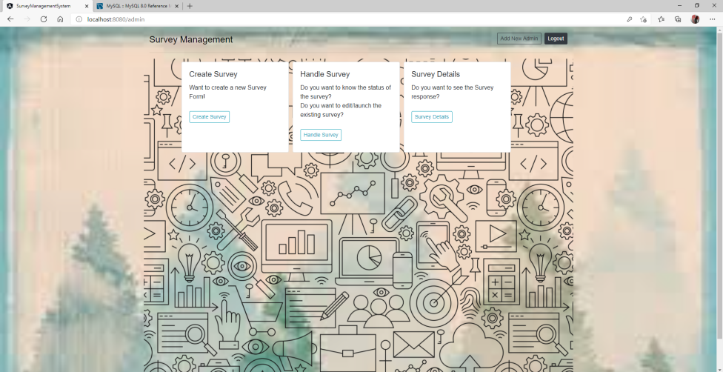
Overview
It is an application used to manage & analyze the survey feedbacks.
Developed using Angular 8.2.x and JAVA Springboot.

Slide 3






Building Blocks
Framework :
Angular 8.2.x (frontend)
Spring Boot (backend)
Tools :
Visual Studio Code
Spring Tool Suite 4
MySQL database(RDBMS)
Postman

Slide 4
Application Flow
Publish Survey
Create Survey
Admin
Edit/Delete Survey
Handle Survey
Individual Survey & Response Details
Survey Details
Home
Logout
All Responses
Add Admin
User
List of Invited Survey’s
List of available survey’s
Request for individual survey
User Registration

Slide 5
Application URL’s
Frontend URL’s :
HomePage : /login
AdminHome: /admin
UserHome: /user
Logout: /logout
CreateSurvey: /createform
HandleSurveys: /Editform/<id>
UserResponses: /usersurvey
SurveyForm: /survey/<id>
SurveyListDetails: /surveylistdetails
IndividualSurveyDetails: /surveylistdetails/<title>
EditIndividualSurvey: /editsurvey
Registration: /registration
RequestingForSurvey: /email/<id>

Slide 6
REST API Endpoints
GET :
/logout
/getAllSurveyList
/surveyList/<id>
/survey /<id>
/userresponseList
/userresponseList /<id>
POST :
/registration
/login
/dynamicform
/surveyList
/saveResponse
/invite/{id}
/editSurveyForm /<id>
DELETE :
/delete /<id>

Slide 7
Database
Capstone
User
Firstname | Lastname | Email | Password | Role
Varchar(255) | Varchar(255) | Varchar(255) (PK) | Varchar(255) | Varchar(255)
Form Data
ID | Form title | Created date | End date | Available | Form format | List of mails
Int(11) (PK) | Varchar(255) | Datetime | Datetime | Boolean | Longtext | Varchar(255)
User Response
ID | Email | Survey Title | Submit Date | Question0 | Answer0 | Question1 | Answer1 | Question0 | Answer0 | Question0 | Answer0 | Question0 | Answer0 | Question0 | Answer0
Int(11) (PK) | Varchar(255) (FK) | Varchar(255) (FK) | Datetime | Varchar(255) | Varchar(255) | Varchar(255) | Varchar(255) | Varchar(255) | Varchar(255) | Varchar(255) | Varchar(255) | Varchar(255) | Varchar(255) | Varchar(255) | Varchar(255)

Slide 8
DEMO

Slide 9
Advantages & Limitations
Advantages :
Easy to get user responses.
Easy to consolidate and analyse the responses.
Dynamic survey forms with multi type questions(radio, checkbox, single line, multi line)
Survey form management
Email notification
Limitations :
Max 6 questions while survey creation

Slide 10
Thank You

